Slide 1


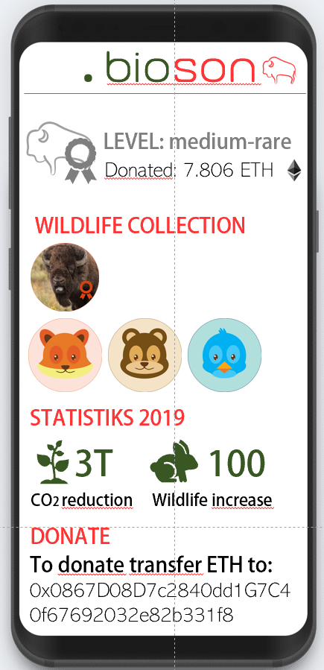
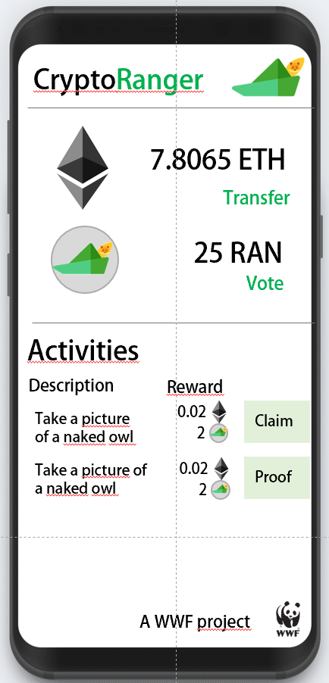
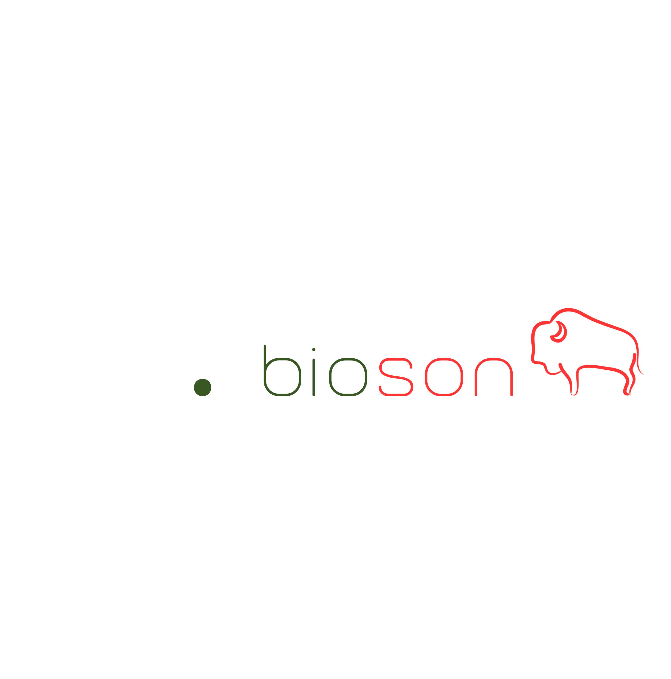


Project Byson
https://github.com/betherworld/byson
The Challenge
How can we use smart contracts to hold the money in escrow that is in the bonus pot and only release it in case the impact goals are met?
How can we use blockchain tokens to incentivize community participation and give them the ability to vote for bonus fund use as described above?
How can blockchain support in controlling that community actions have been conducted as planned? How can we show results of project actions and impact goals?
Tokenization?
Blockchain? Energy efficiency? Really needed?
CryptoRanger
Alessandro
Tarantola
Chaoran
Chen
David
Ittah
Sergiu
Soima
Severin
Kranz

Slide 2
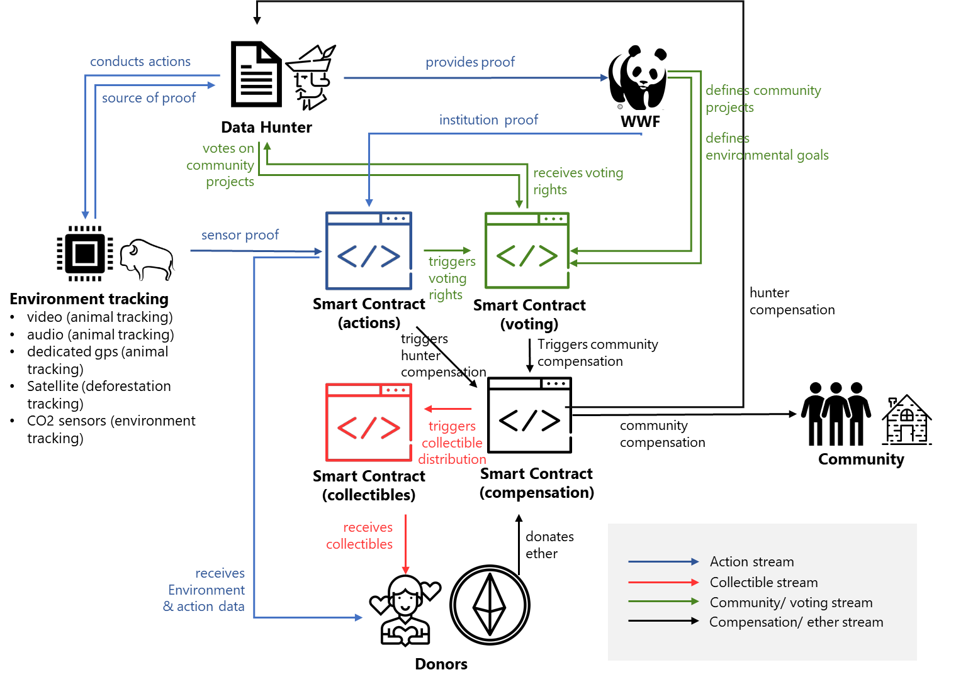
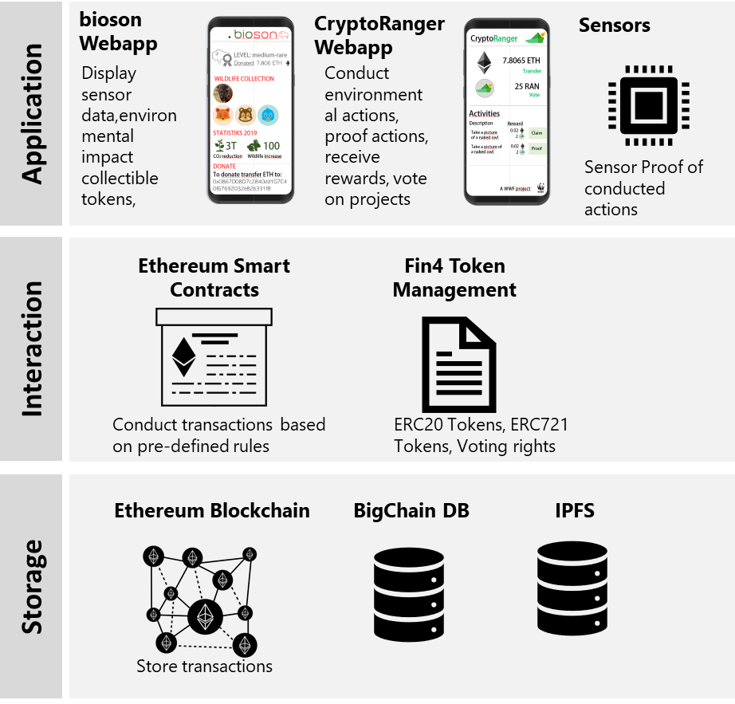
Crypto-Economic Design
System Architecture
The Idea
Doners: donate cryptocurrency specifying the percentage they want to devolve to the community and to the hunters/gatherers directly. Get no fungible tokens in exchange (i.e. cryptobisons). They have access to data (stored in the blockchain) about the present state of certain main goals that have to be achieved

Slide 3


Disruption Potential
For the Environment
For the Community
For the Doners
Doners: donate cryptocurrency specifying the percentage they want to devolve to the community and to the hunters/gatherers directly. Get no fungible tokens in exchange (i.e. cryptobisons). They have access to data (stored in the blockchain) about the present state of certain main goals that have to be achievedDoners: donate cryptocurrency specifying the percentage they want to devolve to the community and to the hunters/gatherers directly. Get no fungible tokens in exchange
Doners: donate cryptocurrency specifying the percentage they want to devolve to the community and to the hunters/gatherers directly. Get no fungible tokens in exchange (i.e. cryptobisons). They have access to data (stored in the blockchain) about the present state of certain main goals that have to be achieved
Doners: donate cryptocurrency specifying the percentage they want to devolve to the community and to the hunters/gatherers directly. Get no fungible tokens in exchange (i.e. cryptobisons). They have access to data (stored in the blockchain) about the present state of certain main goals that have to be achieved
Doners: donate cryptocurrency specifying the percentage they want to devolve to the community and to the hunters/gatherers directly. Get no fungible tokens in exchange (i.e. cryptobisons). They have access to data (stored in the blockchain) about the present state of certain main goals that have to be achieved
Doners: donate cryptocurrency specifying the percentage they want to devolve
to the community and to the hunters/gatherers directly. Get no fungible tokens
Doners: donate cryptocurrency specifying the percentage they want to devolve
to the community and to the hunters/gatherers directly. Get no fungible tokens
Doners: donate cryptocurrency specifying the percentage they want to devolve
to the community and to the hunters/gatherers directly. Get no fungible tokens

Slide 4
Potential negative outcomes
Open questions and ideas
Challenges
General description
Doners: donate cryptocurrency specifying the percentage they want to devolve to the community and to the hunters/gatherers directly. Get no fungible tokens in exchange (i.e. cryptobisons). They have access to data (stored in the blockchain) about the present state of certain main goals that have to be achieved
Doners: donate cryptocurrency specifying the percentage they want to devolve to the community and to the hunters/gatherers directly. Get no fungible tokens in exchange (i.e. cryptobisons). They have access to data (stored in the blockchain) about the present state of certain main goals that have to be achieved
Doners: donate cryptocurrency specifying the percentage they want to devolve
to the community and to the hunters/gatherers directly. Get no fungible tokens
Doners: donate cryptocurrency specifying the percentage they want to devolve
to the community and to the hunters/gatherers directly. Get no fungible tokens

Slide 5
Software Demo
Insert Youtoube Link
Listen to the users of our application and checkout our software demo to get an idea of how our ecosystem might look like.

Slide 6
Byson is a business ecosystem to protect the European nature and wildlife. It consists out of four main parties. The doners donate cryptocurrency to a smart contract y specifying the percentage they want to devolve to the community and to the hunters/gatherers directly. Get no fungible tokens in exchange (i.e. cryptobisons). They have access to data (stored in the blockchain) about the present state of certain main goals that have to be achieved and future projects for the development of the community. Such goals are defined by WWF (e.g increase in number of bisons, large carnivores, bugs, etc.). The proof of a goal being achieved should be automatic and triggered by IoT devices displaced in the area.
2. Community: A considerable amount of funding gets stored in a “community pot”. It is made available once certain Impact Goals have been achieved (proof as before). The hunters/gatherer then vote the project the want to realize with that money, using a Voting Token received for performing proven actions. Projects are chosen by WWF.
3. Hunters/gatherers: perform actions that help implement/maintain IoT structure or actively contribute in preserving the area. For every such actin they receive a money-equivalent cryptocurrency (i.e. ether) as well as a certain amount of voting tokens (VT), to be used as specified before.
4. Nature: IoT sensors to confirm that actions have really been carried out.
5. WWF: take part of the funds to continue doing their everyday tasks. Decide alongside local governance the projects that could be realized with the community pot.

Slide 7



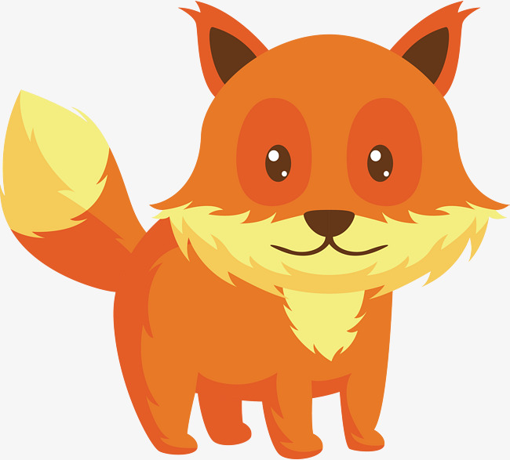





.bioson

Slide 8




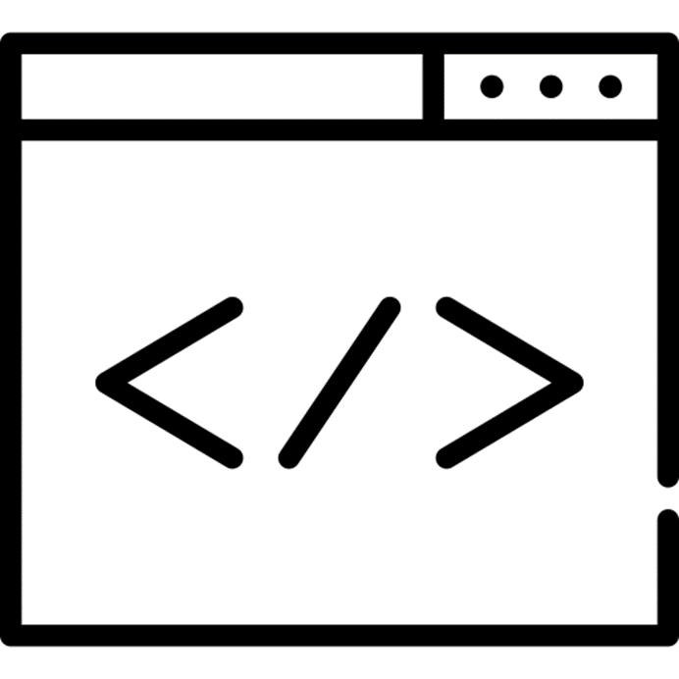
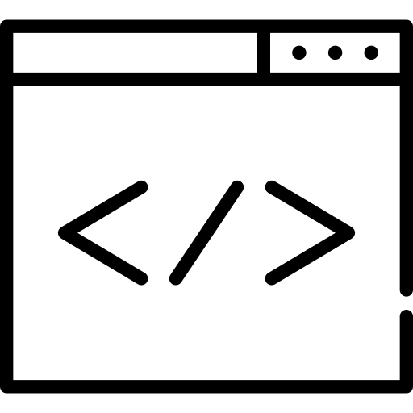

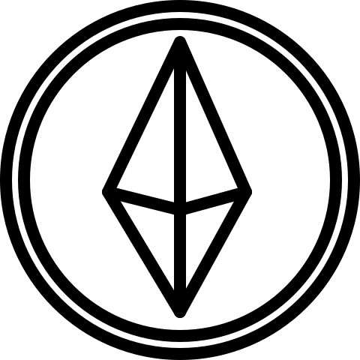
.bioson
CryptoRanger
conducts actions
provides proof
source of proof
defines community projects
Data Hunter
institution proof
WWF
votes on community projects
defines environmental goals
receives voting rights
sensor proof
triggers voting rights
Environment tracking
video (animal tracking)
audio (animal tracking)
dedicated gps (animal tracking)
Satellite (deforestation tracking)
CO2 sensors (environment tracking)
Smart Contract (actions)
Smart Contract (voting)
hunter
compensation
triggers
hunter
compensation
Triggers community
compensation
triggers collectible distribution
community
compensation
Community
Smart Contract (collectibles)
Smart Contract (compensation)
receives collectibles
donates
ether
receives
Environment & action data
Action stream
Collectible stream
Community/ voting stream
Compensation/ ether stream
Donors

Slide 9
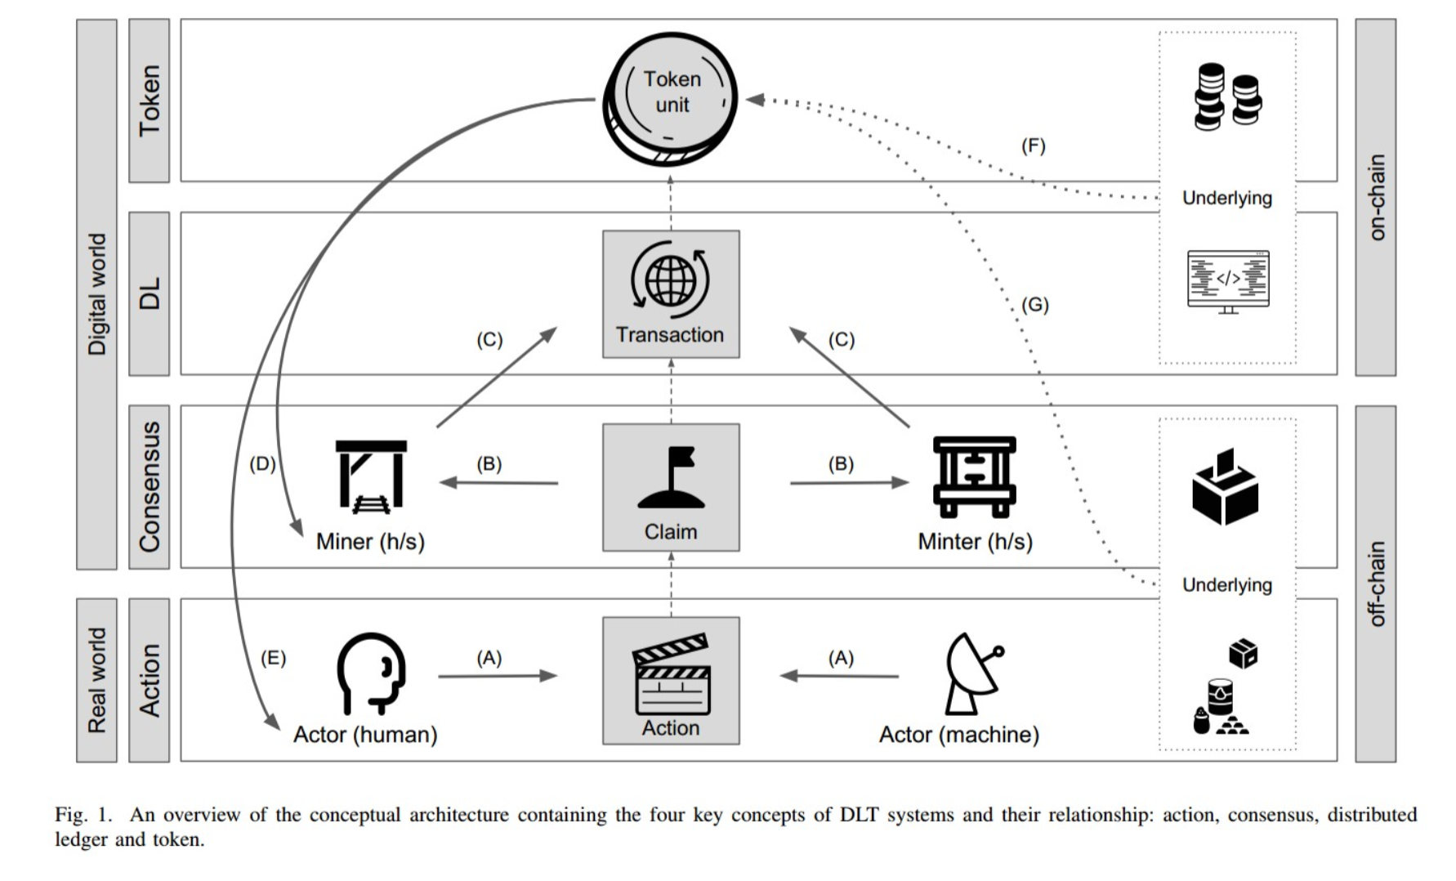
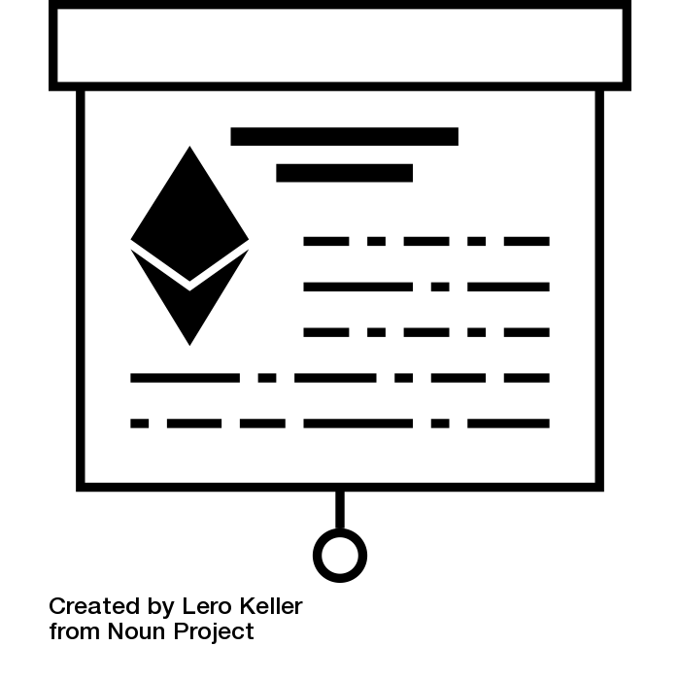
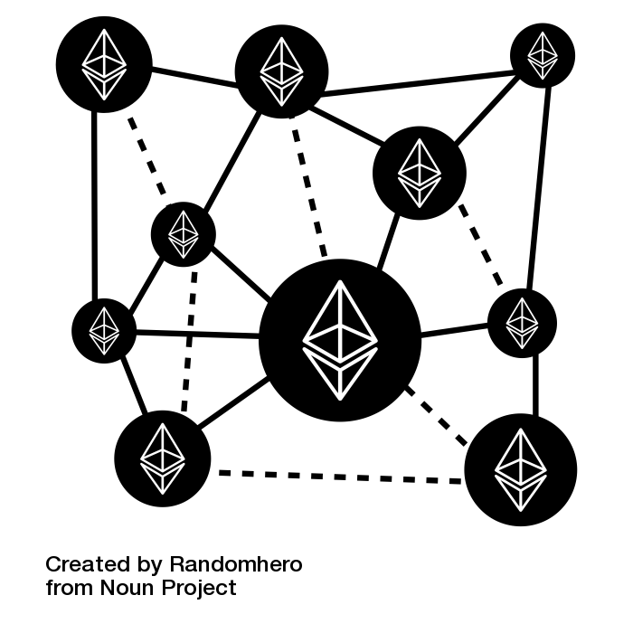

bioson
Webapp
CryptoRanger
Webapp
Sensors
Display sensor data,environmental impact collectible tokens,
Conduct environmental actions, proof actions, receive rewards, vote on projects
Application
Sensor Proof of conducted actions
Ethereum Smart Contracts
Fin4 Token Management
Interaction
Conduct transactions based on pre-defined rules
ERC20 Tokens, ERC721 Tokens, Voting rights
Ethereum Blockchain
BigChain DB
IPFS
Storage
Store transactions
store asset details
& sensor data
store proof data (video, text)

